Slide 1
ADT 10-1
Characteristics
• A table ADT T stores data of some type (tableElementType) with an associated key (tableKeyType).
Operations
bool T.lookup(tableKeyType lookupKey,
tableElementType & data)
precondition: None
Postcondition: If lookupKey equals a key in the table, the value of data is set to the data associated with that key; otherwise, the value of data is undefined.
Returns: true if and only if lookupKey equals a key in the table
26年 11月 8日
Copyright 1997, Oxford University Press. All rights reserved.

Slide 2
ADT 10-1
void T.insert(tableKeyType insertKey,
tableElementType insertData)
Precondition: None
Postcondition: insertData and associated insertKey are stored in T, i.e., T.lookup(insertKey, data) == true, and the value of data will
be set to insertData upon return.
Note: The Postcondition implies that if insertKey duplicates an existing key within the table, the data associated with that key is replaced by insertData.
26年 11月 8日
Copyright 1997, Oxford University Press. All rights reserved.

Slide 3
ADT 10-1
void T.deleteKey(tableKeyType deleteKey)
Precondition: None
Postcondition: T.lookup(deleteKey, data) will return false
26年 11月 8日
Copyright 1997, Oxford University Press. All rights reserved.

Slide 4
Code Example 10-1
// cx10-1.h
// Code Example 10-1: Interface File for Table Implemented with Linear Search
#ifndef __MB_CX10_1__
#define __MB_CX10_1__
#include "dslib.h"
// for an array implementation, need a max table size
const int MAX_TABLE = 100;
template < class tableKeyType, class tableDataType >
26年 11月 8日
Copyright 1997, Oxford University Press. All rights reserved.

Slide 5
Code Example 10-1
class Table
{
public:
Table(); // Table constructor
bool lookup(tableKeyType lookupKey, tableDataType & data);
void insert(tableKeyType insertKey, tableDataType insertData);
void deleteKey(tableKeyType deleteKey);
private:
// implementation via an unordered array of structs
26年 11月 8日
Copyright 1997, Oxford University Press. All rights reserved.

Slide 6
Code Example 10-1
struct item {
tableKeyType key;
tableDataType data;
};
item T[MAX_TABLE]; // stores the items in the table
int entries; // keep track of number of entries in table
int search(tableKeyType key); // an internal routine for searching table
};
#endif
26年 11月 8日
Copyright 1997, Oxford University Press. All rights reserved.

Slide 7
Code Example 10-2
// cx10-2.cpp
// Code Example 10-2: Implementation File: Hash Table
#include "cx10-1.h"
template < class tableKeyType, class tableDataType >
int
Table < tableKeyType, tableDataType >
::search(tableKeyType key)
{
// internal routine for implementation --
// searches in table for the key --
26年 11月 8日
Copyright 1997, Oxford University Press. All rights reserved.

Slide 8
Code Example 10-2
// if found, returns its position;
// else it returns the current value of
// "entries" -- which is the index 1 past the
// last item in the table
int pos;
for (pos = 0; pos < entries && T[pos].key != key; pos++)
;
return pos;
}
template < class tableKeyType, class tableDataType >
Table < tableKeyType, tableDataType >::Table()
{
entries = 0;
}
26年 11月 8日
Copyright 1997, Oxford University Press. All rights reserved.

Slide 9
Code Example 10-2
template < class tableKeyType, class tableDataType >
void
Table < tableKeyType, tableDataType >
::insert(tableKeyType key, tableDataType data)
{
assert(entries < MAX_TABLE);
int pos(search(key)); // set pos to search results
if (pos == entries) // new key
entries++;
T[pos].key = key;
T[pos].data = data;
}
26年 11月 8日
Copyright 1997, Oxford University Press. All rights reserved.

Slide 10
Code Example 10-2
template < class tableKeyType, class tableDataType >
bool
Table < tableKeyType, tableDataType >
::lookup(tableKeyType key, tableDataType &data)
{
int pos(search(key)); // set pos to search results
if (pos == entries) // not found
return false;
else {
data = T[pos].data;
return true;
}
}
26年 11月 8日
Copyright 1997, Oxford University Press. All rights reserved.

Slide 11
Code Example 10-2
template < class tableKeyType, class tableDataType >
void Table < tableKeyType, tableDataType >
::deleteKey(tableKeyType key)
{
int pos(search(key)); // set pos to search results
if (pos < entries) { // otherwise, it wasn't found, so do nothing
// copy last entry into this position
--entries;
T[pos] = T[entries];
}
}
26年 11月 8日
Copyright 1997, Oxford University Press. All rights reserved.

Slide 12
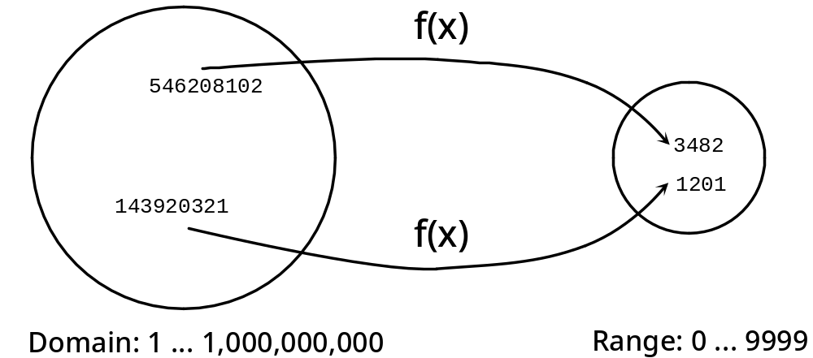
Hash table(Figure 10-1: Hash function map)
SSN -> employer
26年 11月 8日
Copyright 1997, Oxford University Press. All rights reserved.

Slide 13
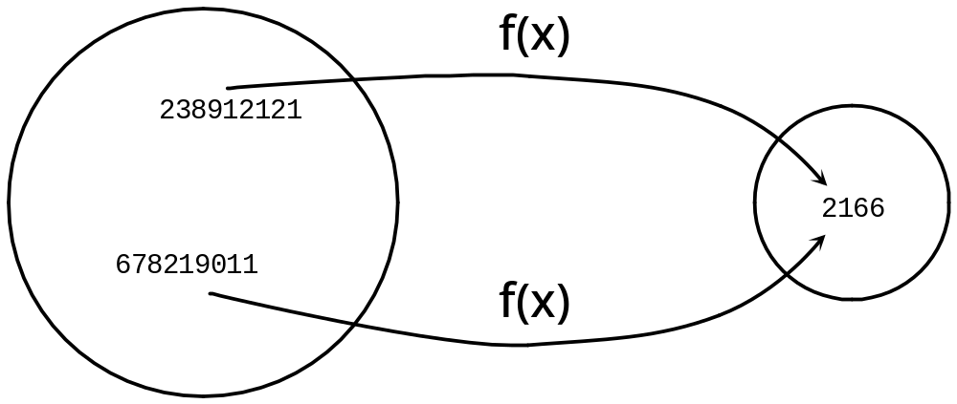
Figure 10-2: A Collision
26年 11月 8日
Copyright 1997, Oxford University Press. All rights reserved.

Slide 14
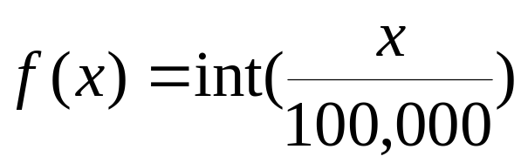
Equation 10-1
Collision chance is high
=> a good hash function depends upon the entire key, rather than just a part
26年 11月 8日
Copyright 1997, Oxford University Press. All rights reserved.

Slide 15
Equation 10-2
home address = key % 11
1. Pick a table size that’s prime
2. Compute the table index from the key using the hash function
index = key % tableSize
26年 11月 8日
Copyright 1997, Oxford University Press. All rights reserved.

Slide 16
Collision handling(fig. 10-3 to fig. 10-6)
Figure 10-3: Hash table after first five entries inserted
0
3
3
0
1
2
3
2
1
3
4
9
8
4
5
6
7
8
4
1
5
9
1
0
7
9
1
26年 11月 8日
Copyright 1997, Oxford University Press. All rights reserved.

Slide 17
Figure 10-4: Hash table after 365 added
0
3
3
0
1
1. can't add 365 at its home address
2
3
2
1
3
4
9
8
2. so probe forward, adding it
4
3
6
5
at the next free slot
5
6
7
8
4
1
5
9
1
0
7
9
1
26年 11月 8日
Copyright 1997, Oxford University Press. All rights reserved.

Slide 18
Figure 10-5: Hash table after 659 added
0
3
3
0
2. wrapping around, next
1
6
5
9
free space found here
2
3
2
1
3
4
9
8
4
3
6
5
5
6
7
8
4
1
9
1. can't add 659 at its home address
1
0
7
9
1
26年 11月 8日
Copyright 1997, Oxford University Press. All rights reserved.

Slide 19
Figure 10-6: Hash table after 321 deleted
0
3
3
0
1
6
5
9
2
3
4
9
8
4
3
6
5
5
6
7
8
4
1
5
9
1
0
7
9
1
26年 11月 8日
Copyright 1997, Oxford University Press. All rights reserved.

Slide 20
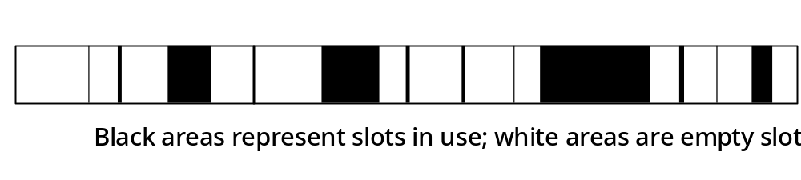
Figure 10-7: Used slots tend to cluster with linear probing
26年 11月 8日
Copyright 1997, Oxford University Press. All rights reserved.

Slide 21
Code Example 10-3
// cx10-3.h
// Code Example 10-3: Interface File: Hash Table
#ifndef __MB_CX10_3__
#define __MB_CX10_3__
#include "dslib.h"
// Implementing a Table via Hashing
// for an array implementation, need a max table size
const int MAX_TABLE = 11;
26年 11月 8日
Copyright 1997, Oxford University Press. All rights reserved.

Slide 22
Code Example 10-3
template < class tableKeyType, class tableDataType >
class Table
{
public:
Table(); // Table constructor
void insert(const tableKeyType & key, const tableDataType & data);
// Precondition: None
// Postcondition: data and associated key are stored in the Table,
// i.e., lookup(key,data) == true and returns the data
// Note: If there was already data stored with this key, the insert
// call will replace it.
26年 11月 8日
Copyright 1997, Oxford University Press. All rights reserved.

Slide 23
Code Example 10-3
bool lookup(const tableKeyType & key, tableDataType & data);
// Precondition: None
// Postcondition: if key is in the table, returns true and associated
// data is returned; otherwise, false is returned and
// data is undefined.
void deleteKey(const tableKeyType & key);
// Precondition: None
// Postcondition: lookup(key,d) returns false
void dump(); // print the contents of the hash table -- handy!
private:
// implementation via a hash table
enum slotType {Empty, Deleted, InUse};
26年 11月 8日
Copyright 1997, Oxford University Press. All rights reserved.

Slide 24
Code Example 10-3
struct slot {
slotType slotStatus;
tableKeyType key;
tableDataType data;
};
slot T[MAX_TABLE]; // stores the items in the table
int entries; // keep track of number of entries in table
int hash(const tableKeyType & key);
// Precondition: none
// Postcondition: none
// Returns: the home address for key
26年 11月 8日
Copyright 1997, Oxford University Press. All rights reserved.

Slide 25
Code Example 10-3
int probe(const int pos);
// Precondition: pos is a slot between 0 and MAX_TABLE-1
// Postcondition: none
// Returns: the next slot, using wrapping (between 0 and MAX_TABLE-1)
bool search(int & pos, const tableKeyType & target);
// Precondition: pos is the hash address of target
// Postcondition: if target is in the table, pos is set to its actual slot
// Returns: true if target is in the table, else false
};
#endif
26年 11月 8日
Copyright 1997, Oxford University Press. All rights reserved.

Slide 26
Code Example 10-4
// cx10-4.cpp
// Code Example 10-4: Implementation File: Hash Table
#include "cx10-3.h"
template < class tableKeyType, class tableDataType >
int
Table < tableKeyType, tableDataType >
::hash(const tableKeyType & key)
{
return key % MAX_TABLE;
}
26年 11月 8日
Copyright 1997, Oxford University Press. All rights reserved.

Slide 27
Code Example 10-4
template < class tableKeyType, class tableDataType >
int
Table < tableKeyType, tableDataType >
::probe(const int pos)
{
if (pos < MAX_TABLE - 1)
return pos + 1;
else
return 0;
}
26年 11月 8日
Copyright 1997, Oxford University Press. All rights reserved.

Slide 28
Code Example 10-4
template < class tableKeyType, class tableDataType >
bool
Table < tableKeyType, tableDataType >
::search(int & pos, const tableKeyType & target)
{
// search for target, starting at pos
for ( ; T[pos].slotStatus != Empty; pos = probe(pos))
if (T[pos].slotStatus == InUse && T[pos].key == target)
return true;
return false;
}
26年 11月 8日
Copyright 1997, Oxford University Press. All rights reserved.

Slide 29
Code Example 10-4
template < class tableKeyType, class tableDataType >
Table < tableKeyType, tableDataType >
::Table() // implementation of Table constructor
{
entries = 0;
int i;
for (i = 0; i < MAX_TABLE; i++)
T[i].slotStatus = Empty;
}
26年 11月 8日
Copyright 1997, Oxford University Press. All rights reserved.

Slide 30
Code Example 10-4
template < class tableKeyType, class tableDataType >
void
Table < tableKeyType, tableDataType >
::insert(const tableKeyType & key, const tableDataType & data)
{
assert(entries < MAX_TABLE - 1);
int pos(hash(key)); // find a position to insert the item
if (!search(pos, key)) { // key was not in the table
// starting at home address, find first free position
pos = hash(key);// search에서 얻은 pos는 처음 만난 empty.
while (T[pos].slotStatus == InUse) / /Empty 나 deleted 중 처음 만나는것
pos = probe(pos);
entries++; // number of entries goes up
}
T[pos].slotStatus = InUse;
26年 11月 8日
Copyright 1997, Oxford University Press. All rights reserved.

Slide 31
Code Example 10-4
T[pos].key = key;
T[pos].data = data;
}
template < class tableKeyType, class tableDataType >
bool
Table < tableKeyType, tableDataType >
::lookup(const tableKeyType & key, tableDataType & data)
{
int pos(hash(key));
if (search(pos, key)) {
data = T[pos].data;
return true;
}
else
return false;
}
26年 11月 8日
Copyright 1997, Oxford University Press. All rights reserved.

Slide 32
Code Example 10-4
template < class tableKeyType, class tableDataType >
void
Table < tableKeyType, tableDataType >::deleteKey(const tableKeyType & key)
{
int pos(hash(key));
if (search(pos, key)) {
T[pos].slotStatus = Deleted;
entries--;
}
}
26年 11月 8日
Copyright 1997, Oxford University Press. All rights reserved.

Slide 33
Code Example 10-4
// the following function is handy for debugging
template < class tableKeyType, class tableDataType >
void
Table < tableKeyType, tableDataType >::dump()
{
int i;
for (i = 0; i < MAX_TABLE; i++) {
cout << i << '\t';
switch(T[i].slotStatus) {
case InUse:
cout << "In Use\t" << T[i].key << endl;
break;
26年 11月 8日
Copyright 1997, Oxford University Press. All rights reserved.

Slide 34
Code Example 10-4
case Deleted:
cout << "Deleted\t" << T[i].key << endl;
break;
case Empty:
cout << "Empty\t" << endl;
break;
}
}
cout << "Entries = " << entries << "\n\n";
}
26年 11月 8日
Copyright 1997, Oxford University Press. All rights reserved.

Slide 35
실습예제
ArrayHash 라는 프로젝트를 만든다
프로젝트에 Table template 클래스를 추가한다.
  프로젝트->새항목추가->헤더파일에서 Table.h라는 파일에 추가하고 그 내용은 20-33쪽 까지 내용 복사
  Main 함수 부위에서 #include “Table.h”
Main 함수에서 tableKeyType 은 int로 TableDataType 은 int 인 table을 생성한다.
Insert 함수를 이용해서 7명의 생일을 년월일순으로 입력한다. 그리고 dump 해 본다.
이중 2개를 지우고, 새로운 1개를 추가하되 지운것 중에 한 곳에 들어갈 수 있는 생일을 입력한다. 그리고 dump
26年 11月 8日
Copyright 1997, Oxford University Press. All rights reserved.

Slide 36
실습예제(계속)
Key 와 데이터를 다른 형식으로 넣어보자. 데이터는 CPhone Class를 추가하는데 이름, 생일을 갖고 있고 이름은 string 생일은 이전의 6자리 수자로 한다. 이 클래스를 추가하고, 앞서 했던 것처럼 Table<int,Cphone> 의 myTable2를 만들고 3개의 데이터를 추가한고 dump
생일을 기억하기는 힘들기 때문에 이름을 key 로 사용하고자 하는데 이름이 string 이므로 stringToInt 함수를 만들어 매개변수로 string 이고 return은 int 가되게 한다. nSum +=strName.at(nIndex); 이걸 사용해서 숫자로 변환
Lookup 을 이용해서 이름으로 찾고 내용을 출력
26年 11月 8日
Copyright 1997, Oxford University Press. All rights reserved.

Slide 37
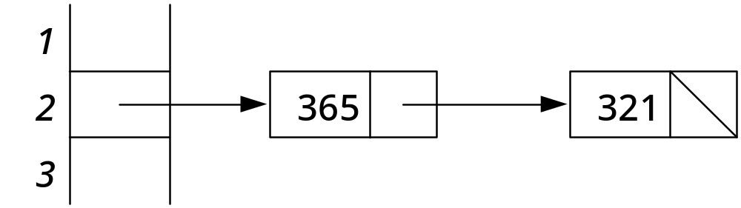
Chained hashing
Figure 10-8: Chained hashing
A linked list stores all the items at a particular home address
26年 11月 8日
Copyright 1997, Oxford University Press. All rights reserved.

Slide 38
Code Example 10-5
// cx10-5.h
// Code Example 10-5: Interface File: Hash Table with Chaining
#ifndef __MB_CX10_5__
#define __MB_CX10_5__
#include "dslib.h"
// Implementing a Table via Hashing
// for an array implementation, need a max table size
const int MAX_TABLE = 11;
26年 11月 8日
Copyright 1997, Oxford University Press. All rights reserved.

Slide 39
Code Example 10-5
template < class tableKeyType, class tableDataType >
class Table
{
public:
Table(); // Table constructor
void insert(const tableKeyType & key, const tableDataType & data);
// Precondition: None
// Postcondition: data and associated key are stored in the Table,
// i.e., lookup(key,data) == true and returns the data
// Note: If there was already data stored with this key, the insert
// call will replace it.
26年 11月 8日
Copyright 1997, Oxford University Press. All rights reserved.

Slide 40
Code Example 10-5
bool lookup(const tableKeyType & key, tableDataType & data);
// Precondition: None
// Postcondition: if key is in the table, returns true and associated
// data is returned; otherwise, false is returned and
// data is undefined.
void deleteKey(const tableKeyType & key);
// Precondition: None
// Postcondition: lookup(key,d) returns false
void dump(); // print the contents of the hash table -- handy!
private:
// implementation via a hash table
struct Slot;
26年 11月 8日
Copyright 1997, Oxford University Press. All rights reserved.

Slide 41
Code Example 10-5
typedef Slot * Link;
struct Slot {
tableKeyType key;
tableDataType data;
Link next;
};
Link T[MAX_TABLE]; // table is an array of pointers to slots
int hash(const tableKeyType & key);
// Precondition: none
// Postcondition: none
// Returns: the home address for key
26年 11月 8日
Copyright 1997, Oxford University Press. All rights reserved.

Slide 42
Code Example 10-5
bool search(Link & slotPointer, const tableKeyType & target);
// Precondition: slotPointer points to the start of the chain for
// target's hash address
// Postcondition: if target is in the chain, slotPointer points to it
// Returns: true if target is in the table, else false
};
#endif
26年 11月 8日
Copyright 1997, Oxford University Press. All rights reserved.

Slide 43
Code Example 10-6
// cx10-6.cpp
// Code Example 10-6: Implementation File: Hash Table with Chaining
#include "cx10-5.h"
template < class tableKeyType, class tableDataType >
int
Table < tableKeyType, tableDataType >
::hash(const tableKeyType & key)
{
return key % MAX_TABLE;
}
26年 11月 8日
Copyright 1997, Oxford University Press. All rights reserved.

Slide 44
Code Example 10-6
template < class tableKeyType, class tableDataType >
bool
Table < tableKeyType, tableDataType >
::search(Link & slotPointer, const tableKeyType & target)
{
// search for target, starting at slotPointer
for ( ; slotPointer; slotPointer = slotPointer -> next)
if (slotPointer->key == target)
return true;
return false;
}
26年 11月 8日
Copyright 1997, Oxford University Press. All rights reserved.

Slide 45
Code Example 10-6
template < class tableKeyType, class tableDataType >
Table < tableKeyType, tableDataType >
::Table() // implementation of Table constructor
{
int i;
for (i = 0; i < MAX_TABLE; i++)
T[i] = 0;
}
template < class tableKeyType, class tableDataType >
void
Table < tableKeyType, tableDataType >
::insert(const tableKeyType & key, const tableDataType & data)
26年 11月 8日
Copyright 1997, Oxford University Press. All rights reserved.

Slide 46
Code Example 10-6
{
int pos(hash(key)); // find a position to insert the item
Link sp(T[pos]);
if (!search(sp, key)) { // key was not in the table
// insert new item at beginning of list
Link insertedSlot = new Slot;
insertedSlot->key = key;
insertedSlot->data = data;
insertedSlot->next = T[pos];
T[pos] = insertedSlot;
}
else // found old record -- update the data
sp->data = data;
}
26年 11月 8日
Copyright 1997, Oxford University Press. All rights reserved.

Slide 47
Code Example 10-6
template < class tableKeyType, class tableDataType >
bool
Table < tableKeyType, tableDataType >
::lookup(const tableKeyType & key, tableDataType & data)
{
int pos(hash(key));
Link sp(T[pos]);
if (search(sp, key)) {
data = sp->data;
return true;
}
else
return false;
}
26年 11月 8日
Copyright 1997, Oxford University Press. All rights reserved.

Slide 48
Code Example 10-6
template < class tableKeyType, class tableDataType >
void
Table < tableKeyType, tableDataType >::deleteKey(const tableKeyType & key)
{
// need to find pointer to item preceding the slot to delete
int pos(hash(key));
Link p;
if (0 == T[pos]) // there's nothing here
return;
if (T[pos]->key == key) { // special case, for first item in chain
Link deleteSlot(T[pos]);
T[pos] = T[pos]->next;
delete deleteSlot;
}
26年 11月 8日
Copyright 1997, Oxford University Press. All rights reserved.

Slide 49
Code Example 10-6
else
for (p = T[pos]; p->next; p = p->next)
if (p->next->key == key) {
Link deleteSlot = p->next;
p->next = p->next->next;
delete deleteSlot;
break;
}
}
26年 11月 8日
Copyright 1997, Oxford University Press. All rights reserved.

Slide 50
Code Example 10-6
// the following function is handy for debugging
template < class tableKeyType, class tableDataType >
void
Table < tableKeyType, tableDataType >::dump()
{
int i;
for (i = 0; i < MAX_TABLE; i++) {
cout << i << '\t';
Link p;
for (p = T[i]; p; p = p->next)
cout << p->key << '\t';
cout << '\n';
}
cout << '\n';
}
26年 11月 8日
Copyright 1997, Oxford University Press. All rights reserved.

Slide 51
실습예제
LinkedListHash 라는 프로젝트를 만든다
프로젝트에 Table template 클래스를 추가한다.
  프로젝트->새항목추가->헤더파일에서 Table.h라는 파일에 추가하고 그 내용은 37-49쪽 까지 내용 복사
  Main 함수 부위에서 #include “Table.h”
이전 프로젝트에서 만든 Cphone 클래스의 *.cpp와 *.h 파일을 현재 프로젝트 디렉토리에 복사하고, 프로젝트->기존항목추가 에서 파일들을 선택하고 추가한다. Table<int,Cphone> 의 myTable를 만들고 3개의 데이터를 추가한고 dump
생일을 기억하기는 힘들기 때문에 이름을 key 로 사용하고자 하는데 이름이 string 이므로 stringToInt 함수를 이전 프로젝트의 table.h에서 복사해 이걸 사용해서 숫자로 변환
Lookup 을 이용해서 이름으로 찾고 내용을 출력
26年 11月 8日
Copyright 1997, Oxford University Press. All rights reserved.

